Slide 1
YouTube • Uploading • livestreaming
Lucinda offer

Slide 2
My experience
Mars Talk Podcast 2016
6 hour Jupiter moons livestream
Venus phosphine announcement via RAS 2020 (simulcast)
RAS Community Meeting w/UK Space, STFC and ESA 2020
Mars Society online conference 2020
National Astronomy Week 2020

Slide 3
Who can do this?
Anyone who is willing to try and wanting to learn
It can be as simple or complex as you want it to be
You want someone who is calm under pressure
You want someone who is good at multi-tasking
You might want someone who has previously dabbled in YT, streaming, etc.

Slide 4
Complex vs simple
65 steps minimal to prepare for every event.
Livestream direct via YT or FB.
Obtain speaker in advance
Set-up Zoom webinar for link
Create ppt slide
Connect to YT for livestream
Make Eventbrite invite
Publish to webpage
Tell our Comms team – alert public
Let Staff and members know – newsletter
More steps for 2 days before, during event and after
Create an account, channel, profile page
Give app permissions
Click a livestream button from phone or computer
Begin livestream
Keep in mind you need to meet certain numbers of subscribers to do some things on YouTube.

Slide 5
Creating a youtube channel

Slide 6
Setting up YouTube (tubics)
Step 1 – Create an account

Slide 7
Setting up YouTube (tubics)
Step 2 – choose either a personal account or for your organization.

Slide 8
Setting up YouTube (tubics)
Step 3 – your personal info, confirmations and agreements to T&Cs

Slide 9
Setting up YouTube (tubics)
Step 4 – Sign In and create a channel

Slide 10
Setting up YouTube (tubics)
Step 5 – Create your Brand Account

Slide 11
Enable livestreaming on youtube
You need to enable your livestreaming capabilities and YouTube will want to confirm this ability with you via your phone number.
Go to:
YouTube > Your channel > Settings > Channel > Feature eligibility > Enable livestreaming via phone verification

Slide 12
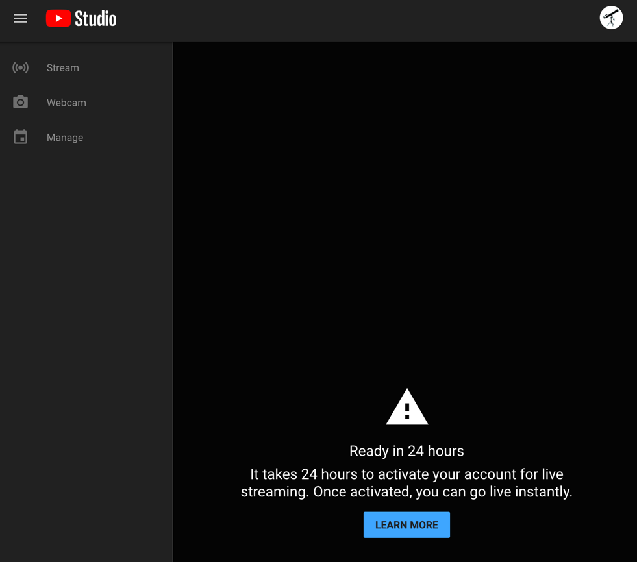
IMPORTANT!!
YOU WILL NEED TO ENABLE LIVESTREAMING 24 HOURS IN ADVANCE IN Youtube SETTINGS

Slide 13
Tubics – youtube how-to videos
https://www.youtube.com/channel/UCoSK_V3cwHyMNBTvzwfOELQ/videos

Slide 14
Let’s do A Quick show around Youtube
I will share the several youtube channels that I manage and intro youtube studio, uploading and how to schedule a live stream

Slide 15
DON’T FORGET THAT YOU ALSO NEED TO ENABLE LIVE STREAMING IN ZOOM TOO
MEETING (advance) SETTINGS AND WEBINAr SETTINGS

Slide 16
Enabling livestream in zoom
For Meetings and webinar

Slide 17
In Zoom - meeting
Step 1 – Go to settings > In Meeting (Advanced)

Slide 18
In Zoom - meeting
Step 2 – Toggle livestreaming to ON and choose which service(s) you want or do custom (which I recommend).

Slide 19
In Zoom - webinar
Step 1 – Select Account Management from the sidebar to reveal webinar settings

Slide 20
In zoom - webinar
Step 2 – Click on ‘Edit’ and make your selection.

Slide 21
How to set up the live stream in zoom

Slide 22
Go to your Zoom meeting or webinar
Once you have created your meeting or webinar in Zoom you need to go back and click on your links (as if to view your set-up, this is not ‘Edit’) to create a live stream.

Slide 23
In Zoom Meetings
Scroll to the bottom of your meeting management page to find ‘Polls’ and ‘Live streaming’. Select the Live streaming tab, then click on ‘configure live stream settings’.

Slide 24
In Zoom webinar
Click on your webinar link to manage it within Zoom (not an edit page). Scroll to the bottom to find several tabs and click on ‘More’ to find ‘Live Streaming’. Then click on ‘+Add Service”.

Slide 25
In Zoom
This panel is in Zoom and will pop up when you create your livestream in your Zoom meeting or webinar within the Zoom interface. However, the info comes from YouTube Studio. Once you have scheduled your future stream in YouTube you copy and paste the links and key here.

Slide 26
IN YOUTUBE
This is in YouTube Studio once you have scheduled a live stream. This is where your Stream Key and Stream URL is. To find the shareable link, you need to go back one page and click on the three dots.

Slide 27
In Youtube
This is the live stream page URL and the last bit of info you need to give Zoom to complete your live stream connection. It is also the link you use to get the word out to the public of your event and it goes to your holding page on YouTube.

Slide 28
In Zoom
THIS IS AN EXAMPLE – DO NOT USE
So now your Zoom meeting or webinar has the information from your YouTube channel to do your livestream when you are ready to start your event. Click save.

Slide 29
In Zoom
When you are ready to live stream, click the three dots in Zoom and select which ever one you opted for in Zoom settings. I always do ’Live on Custom Live Streaming Service’ because it also allows me to simulcast if I want to on both YouTube and Facebook via simulcast software like Restream.io, and I can also use it to just stream on just YouTube. It is versatile.

Slide 30
THIS IS THE MINIMUM YOU NEED TO DO TO A LIVE STREAM FROM ZOOM TO YOUR YOUTUBE CHANNEL.
Give it a go on a personal account and share with family and friends. You can make the videos private and eventually delete them just for a trial and practice before you are ready to set it up for your organization and create a branding account. Good luck, have fun, and remember that YouTube is also a resource for How-To videos to learn more.

